Slide 1
Topic 2: Combinational Logic Circuit
Analysis and design of combinational logic circuit
Hazard

Slide 2
Carry Look-ahead Adder
The speed with which an addition can be performed is limited by the time required for the carries to propagate through all the stages of a parallel adder.
One method of speeding up the addition process by eliminating this ripple carry delay is called look-ahead carry addition.
The look-ahead carry adder anticipates the output carry of each stage, and based on the inputs, produces the output carry by either carry generation or carry propagation.
<number> / 65
Notes:
Princess Sumaya University
4241 - Digital Logic Design
Dr. Bassam Kahhaleh

Slide 3
Carry Look-ahead Adder
Carry generation occurs when an output carry is produced internally by the full-adder. A carry is generated only when both input bits are 1s. The generated carry, Cg, is expressed as the AND function of the two input bits, A and B.
Cg _x001f_= AB
Carry propagation occurs when the input carry is rippled to become the output carry. An input carry may be propagated by the full-adder when either or both of the input bits are 1s. The propagated carry, Cp, is expressed as the OR function of the input bits.
Cp _x001f_= A +_x001e_ B
<number> / 65
Notes:
Princess Sumaya University
4241 - Digital Logic Design
Dr. Bassam Kahhaleh

Slide 4

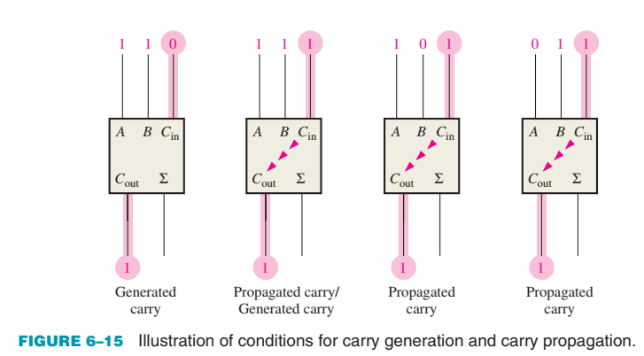
Carry Look-ahead Adder
The output carry of a full-adder can be expressed in terms of both the generated carry (Cg) and the propagated carry (Cp).
<number> / 65
Notes:
Princess Sumaya University
4241 - Digital Logic Design
Dr. Bassam Kahhaleh

Slide 5
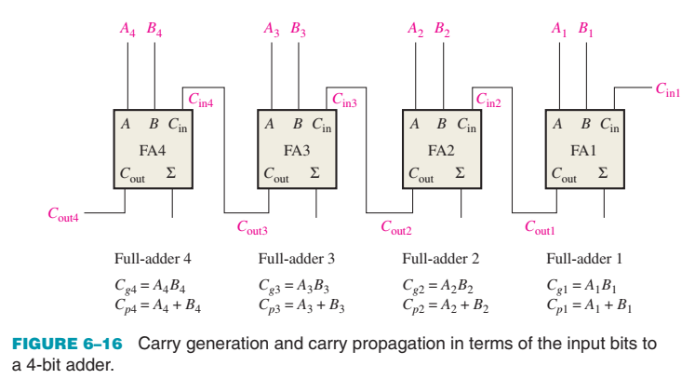
Carry Look-ahead Adder
For each full-adder, the output carry is dependent on (Cg), (Cp), and (Cin).The Cg and Cp functions for each stage are immediately available as soon as the input bits A and B and the input carry to the LSB adder are applied
<number> / 65
Notes:
Princess Sumaya University
4241 - Digital Logic Design
Dr. Bassam Kahhaleh

Slide 6
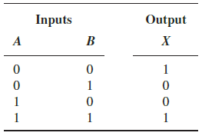

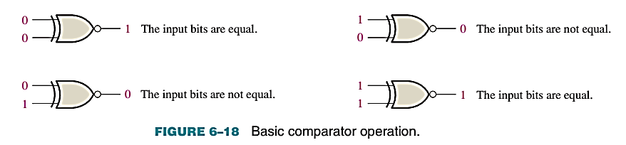
Magnitude Comparator
  The basic function of a comparator is to compare the magnitudes of two binary quantities to determine the relationship of those quantities
  3 possible Outputs: < , = , >
X = (A ⊕ B)’ = A’.B’ + A.B
<number> / 65
Notes:
Princess Sumaya University
4241 - Digital Logic Design
Dr. Bassam Kahhaleh

Slide 7
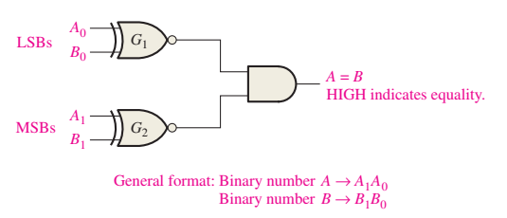
Magnitude Comparator
  In order to compare binary numbers containing two bits each, an additional XNOR gate is necessary. The two least significant bits (LSBs) of the two numbers are compared by gate G1, and the two most significant bits (MSBs) are compared by gate G2, as shown in Figure 6–19. If the two numbers are equal, their corresponding bits are the same, and the output of each exclusive-NOR gate is a 1. If the corresponding sets of bits are not equal, a 0 occurs on that exclusive-NOR gate output.
<number> / 65
Notes:
Princess Sumaya University
4241 - Digital Logic Design
Dr. Bassam Kahhaleh

Slide 8
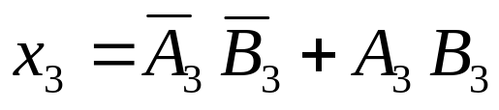
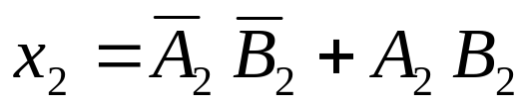
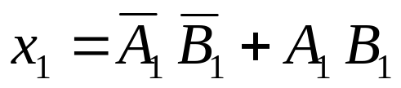
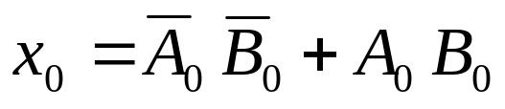
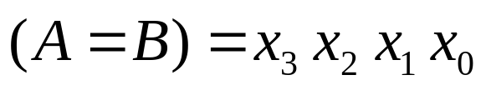
Magnitude Comparator
Compare 4-bit number to 4-bit number
A₃A₂A₁A₀ B₃B₂B₁B₀
Magnitude Comparator
A<B A=B A>B
<number> / 65
Notes:
Princess Sumaya University
4241 - Digital Logic Design
Dr. Bassam Kahhaleh

Slide 9
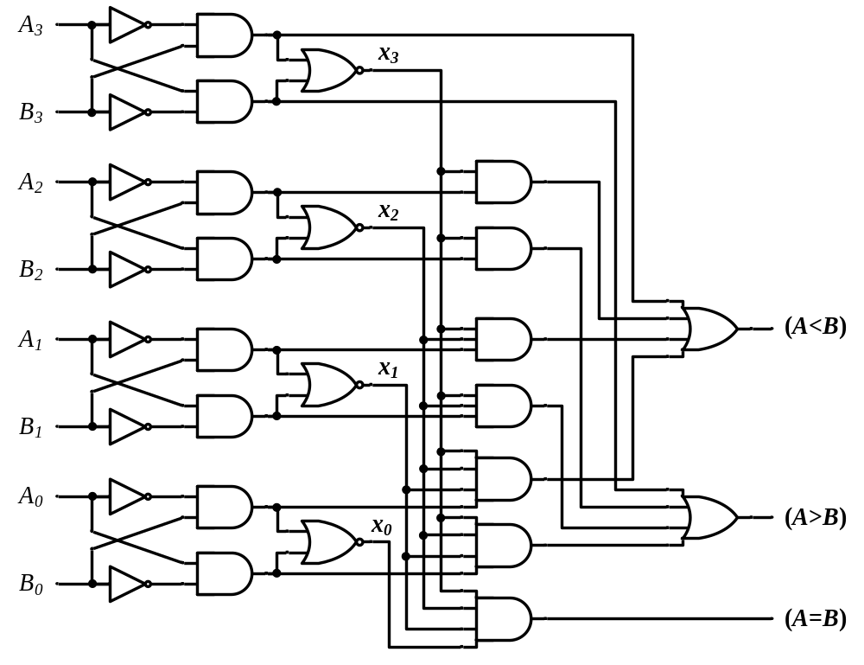
Magnitude Comparator
<number> / 65
Notes:
Princess Sumaya University
4241 - Digital Logic Design
Dr. Bassam Kahhaleh

Slide 10
Decoders
Extract “Information” from the code
  Example: 2-bit Binary Number
  N – input and 2^N- Output
  For N inputs, only 1 output will be active
Only one lamp will turn on
0
1
2
3
Binary
Decoder
1
0
0
0
x₁
x₀
0
0
<number> / 65
Notes:
Princess Sumaya University
4241 - Digital Logic Design
Dr. Bassam Kahhaleh

Slide 11
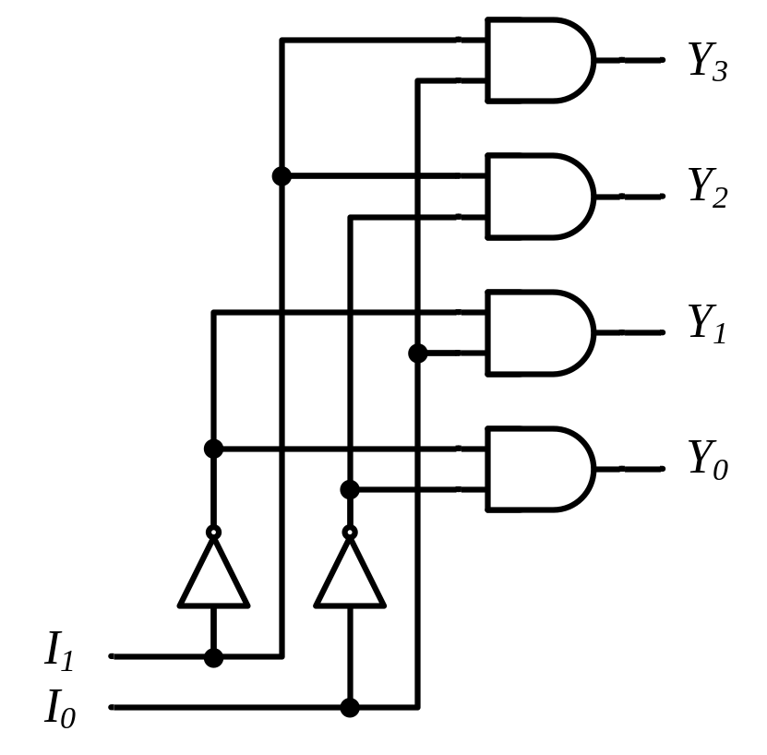
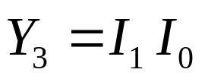
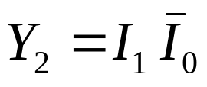
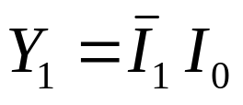
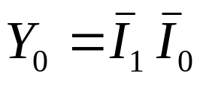
Decoders
Binary (2-to-4 Line) Decoder
Binary
Decoder
y₃
y₂
y₁
y₀
I₁
I₀
I₁ I₀ | Y₃ Y₂ Y₁ Y₀
0 0 | 0 0 0 1
0 1 | 0 0 1 0
1 0 | 0 1 0 0
1 1 | 1 0 0 0
<number> / 65
Notes:
Princess Sumaya University
4241 - Digital Logic Design
Dr. Bassam Kahhaleh

Slide 12
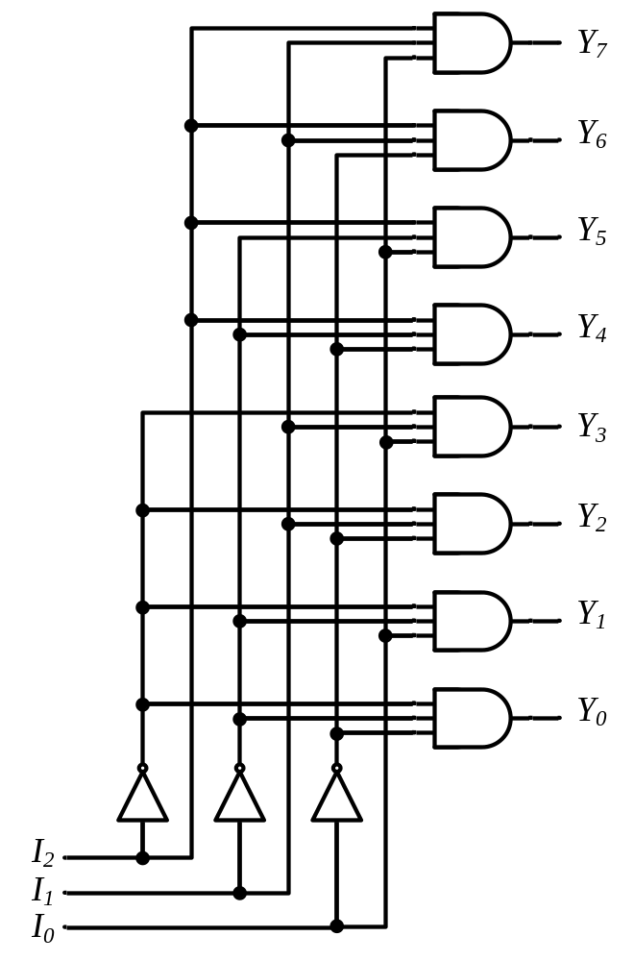








Decoders
3-to-8 Line Decoder
Binary
Decoder
Y₇
Y₆
Y₅
Y₄ Y₃
Y₂
Y₁
Y₀
I₂
I₁
I₀
<number> / 65
Notes:
Princess Sumaya University
4241 - Digital Logic Design
Dr. Bassam Kahhaleh

Slide 13
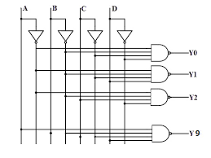
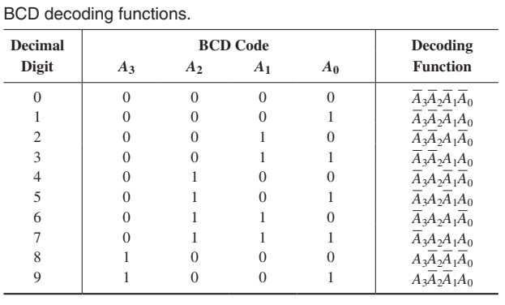
Decoders
BCD to Decimal Decoder
<number> / 65
Notes:
Princess Sumaya University
4241 - Digital Logic Design
Dr. Bassam Kahhaleh

Slide 14
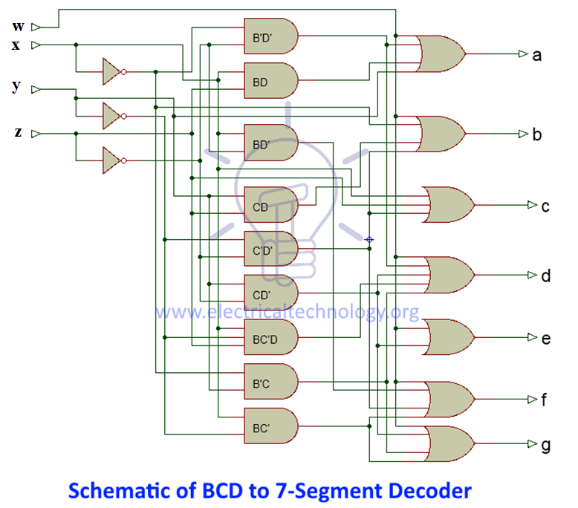
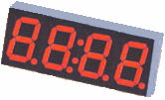
BCD to Seven-Segment Decoder
a
w x y z | a b c d e f g
0 0 0 0 | 1 1 1 1 1 1 0
0 0 0 1 | 0 1 1 0 0 0 0
0 0 1 0 | 1 1 0 1 1 0 1
0 0 1 1 | 1 1 1 1 0 0 1
0 1 0 0 | 0 1 1 0 0 1 1
0 1 0 1 | 1 0 1 1 0 1 1
0 1 1 0 | 1 0 1 1 1 1 1
0 1 1 1 | 1 1 1 0 0 0 0
1 0 0 0 | 1 1 1 1 1 1 1
1 0 0 1 | 1 1 1 1 0 1 1
1 0 1 0 | x x x x x x x
1 0 1 1 | x x x x x x x
1 1 0 0 | x x x x x x x
1 1 0 1 | x x x x x x x
1 1 1 0 | x x x x x x x
1 1 1 1 | x x x x x x x
w
x
y
z
a
b
c
d
e
f
g
f
b
?
g
e
c
BCD code
d
 |  |  |  | y
 |  | 1 |  | 1 | 1
 |  |  | 1 | 1 | 1 | x
w |  | x | x | x | x
 |  | 1 | 1 | x | x
 |  |  | z
a = w + y + xz + x’z’
b = . . .
c = . . .
d = . . .
<number> / 65
Notes:
Princess Sumaya University
4241 - Digital Logic Design
Dr. Bassam Kahhaleh

Slide 15
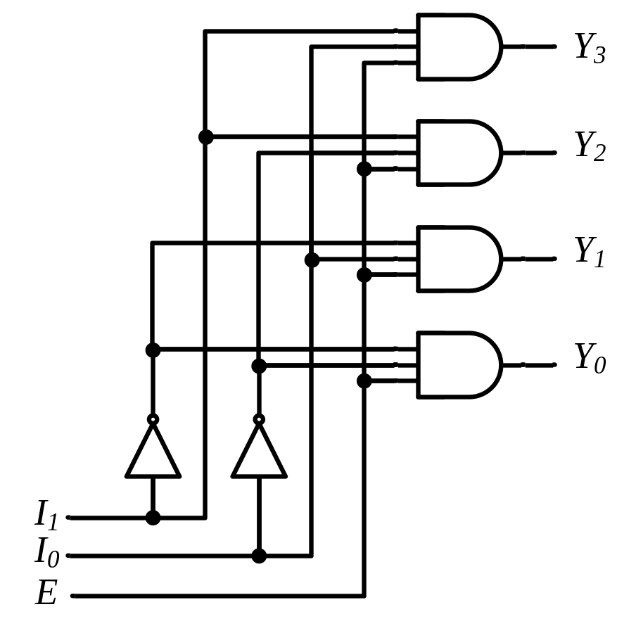
Decoders
“Enable” Control
Binary
Decoder
Y₃
Y₂
Y₁
Y₀
I₁
I₀
E
E | I₁ I₀ | Y₃ Y₂ Y₁ Y₀
0 | x x | 0 0 0 0
1 | 0 0 | 0 0 0 1
1 | 0 1 | 0 0 1 0
1 | 1 0 | 0 1 0 0
1 | 1 1 | 1 0 0 0
<number> / 65
Notes:
Princess Sumaya University
4241 - Digital Logic Design
Dr. Bassam Kahhaleh

Slide 16
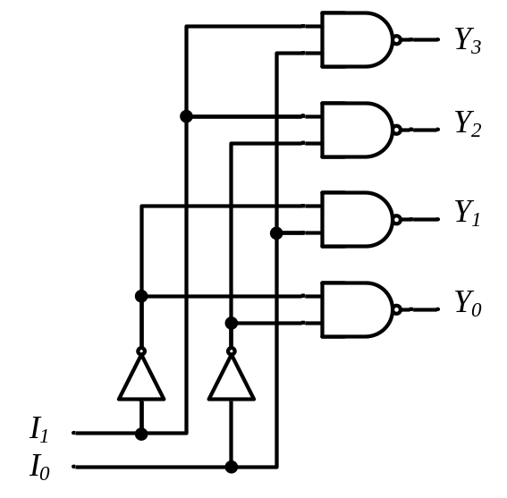
Decoders
Active-High / Active-Low
I₁ I₀ | Y₃ Y₂ Y₁ Y₀
0 0 | 0 0 0 1
0 1 | 0 0 1 0
1 0 | 0 1 0 0
1 1 | 1 0 0 0
I₁ I₀ | Y₃ Y₂ Y₁ Y₀
0 0 | 1 1 1 0
0 1 | 1 1 0 1
1 0 | 1 0 1 1
1 1 | 0 1 1 1
Binary
Decoder
Binary
Decoder
Y₃
Y₂
Y₁
Y₀
Y₃
Y₂
Y₁
Y₀
I₁
I₀
I₁
I₀
<number> / 65
Notes:
Princess Sumaya University
4241 - Digital Logic Design
Dr. Bassam Kahhaleh

Slide 17

Encoders
Put “Information” into code
  2^N- input and N – output
  For 2^N inputs, all out put will be high or low
Only one input switch should be activated at a time
1
x₁
x₂
x₃
Binary
Encoder
x₃ x₂ x₁ | y₁ y₀
0 0 0 | 0 0
0 0 1 | 0 1
0 1 0 | 1 0
1 0 0 | 1 1
y₁
y₀
2
3
<number> / 65
Notes:
Princess Sumaya University
4241 - Digital Logic Design
Dr. Bassam Kahhaleh

Slide 18
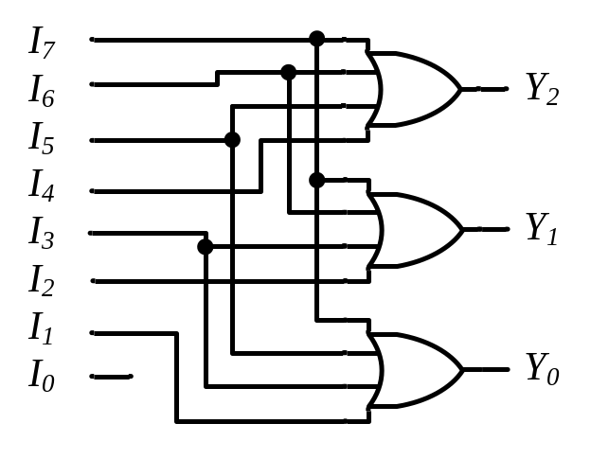
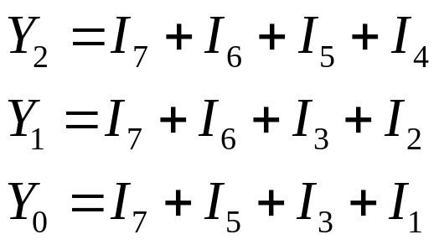
Encoders
Binary
Encoder
Octal-to-Binary Encoder (8-to-3)
I₇
I₆
I₅
I₄ I₃
I₂
I₁
I₀
I₇ I₆ I₅ I₄ I₃ I₂ I₁ I₀ | Y₂ Y₁ Y₀
0 0 0 0 0 0 0 1 | 0 0 0
0 0 0 0 0 0 1 0 | 0 0 1
0 0 0 0 0 1 0 0 | 0 1 0
0 0 0 0 1 0 0 0 | 0 1 1
0 0 0 1 0 0 0 0 | 1 0 0
0 0 1 0 0 0 0 0 | 1 0 1
0 1 0 0 0 0 0 0 | 1 1 0
1 0 0 0 0 0 0 0 | 1 1 1
Y₂
Y₁
Y₀
<number> / 65
Notes:
Princess Sumaya University
4241 - Digital Logic Design
Dr. Bassam Kahhaleh

Slide 19
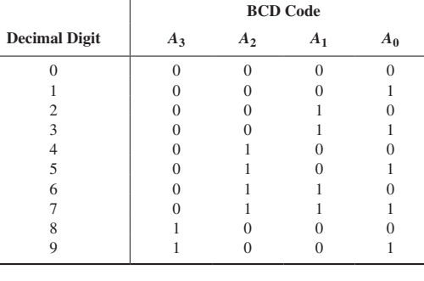
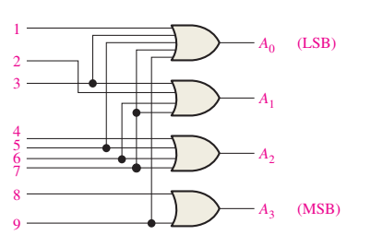

Encoders
Decimal-to-Binary Encoder (10-to-4)
<number> / 65
Notes:
Princess Sumaya University
4241 - Digital Logic Design
Dr. Bassam Kahhaleh

Slide 20
Encoder / Decoder Pairs
Binary
Encoder
Binary
Decoder
Y₇
Y₆
Y₅
Y₄ Y₃
Y₂
Y₁
Y₀
7
7
I₇
I₆
I₅
I₄ I₃
I₂
I₁
I₀
6
6
5
5
Y₂
Y₁
Y₀
I₂
I₁
I₀
4
4
3
3
2
2
1
1
0
0
<number> / 65
Notes:
Princess Sumaya University
4241 - Digital Logic Design
Dr. Bassam Kahhaleh

Slide 21

Any Questions

Slide 22
Design a BCD to gray code converter using a decoder

